Slide 1

instant
edge
NUS – ISS Internship
Team 4FT
Prototype V1.0
30th Nov 2016
The Enterprise Transformation Platform
BUSINESS CONFIDENTIAL
© 2015 Instant Edge Pte Ltd. All rights reserved.

Slide 2

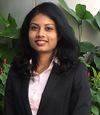

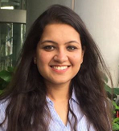

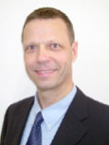
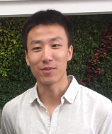
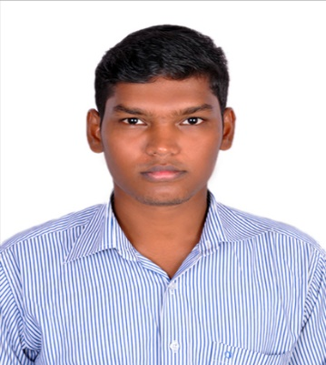
NUS-ISS TEAM
Rameswari Mohanty Project Manager
Vrinda Gupta Quality Manager
Sebastian Voss Co-Founder & CEO
Dr. Mathias Behne
Co-Founder & CTO
Zhao Pengcheng Software Architect
Vignesh Selvaraju Configuration Manager

Slide 3
Project Organization
No. | Role | Acronym | Person in Charge | Organization
1 | User Representative | UR | Mathias Behne | Instant Edge
2 | Project Manager | PM | Rameswari Mohanty | ISS
3 | Quality Manager | QM | Vrinda Gupta | ISS
4 | Configuration Manager | CM | Selvaraju Vignesh | ISS
5 | Software Architect | TA | Zhao Pengcheng | ISS
6 | Technical Leader | TL | Zhao Pengcheng | ISS
7 | Business Analyst | BA | Rameswari Mohanty | ISS
8 | Software Developer | DP | Zhao Pengcheng , Selvaraju Vignesh , Rameswari Mohanty , Vrinda Gupta | ISS
9 | Software Tester | WP | Zhao Pengcheng , Selvaraju Vignesh , Rameswari Mohanty , Vrinda Gupta | ISS

Slide 4
Organization Overview
Instant Edge is a Young and first growing start up based out of Singapore , Founded by Ex-SAP Managers with an aim to develop a platform that provides integrated easy-to-use best practices content (PMBOK, PRINCE2, ITIL, ASAP, templates) enabling any kind or size of enterprise to successfully plan, execute and monitor any type or size of transformational initiative in a highly efficient manner.
The organizational vision is:
The Instant Edge Platform is structured for following business process areas:
Ensure Benefits delivery
Manage Changes
Manage Programs and Projects
Manage Operations
Manage Organizations
Enable Cradle-to-Grave Product Management to create value sooner with superior outcomes at significantly reduced risks

Slide 5
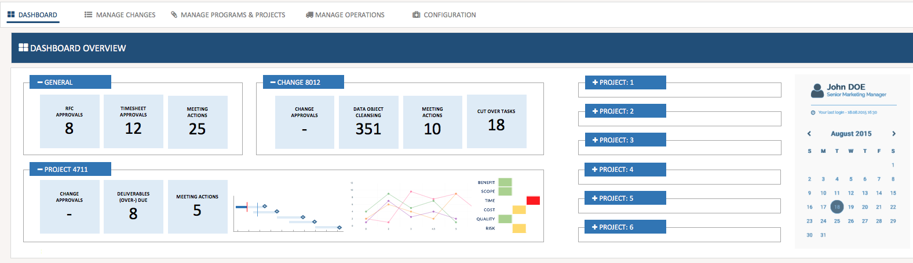


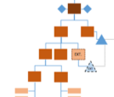
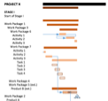
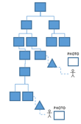

Vision
FEATURES
MARKET
TIMELINE
VISION
TEAM
TECH
The Solution: Product Management, re-envisioned! Architecture:
 ENSURE
BENEFITS DELIVERY
 PORTFOLIO COCKPIT
 MANAGE CHANGES
 IDEATION
 REQUEST
■ REVIEW
⇧ ASSESS

AUTHORIZE
⬧ SCHEDULE
➔ EXECUTE
✗ DEPLOY

OPERATE

RETIRE
➔ MANAGE PROGRAMS & PROJECTS
 MANAGE OPERATIONS
A. DEFINE SCOPE
B. DEFINE & SEQUENCE ACTIVITIES
 INITIATION
 PLANNING
 INCIDENT MANAGEMENT & SERVICE REQUESTS
 PLANNING
 EXECUTING
❑ PROBLEM MANAGEMENT
 MONITOR & CONTROLLING
 ACCESS MANAGEMENT
◉ DIRECT & MANAGE PROJECT WORK
 CLOSING
 MANAGE CONTINUITY & PROCESS CONTROLS
D. DEVELOP SCHEDULE
C. ESTIMATE & ASSIGN RESOURCES
⬅ PERFORM INTEGRATED CHANGE CONTROL
 MANAGE COMMUNICATIONS
NUS-ISS INTERNSHIP
 CONDUCT PROCUREMENTS
 MANAGE STAKEHOLDER ENGAGEMENT

Slide 6
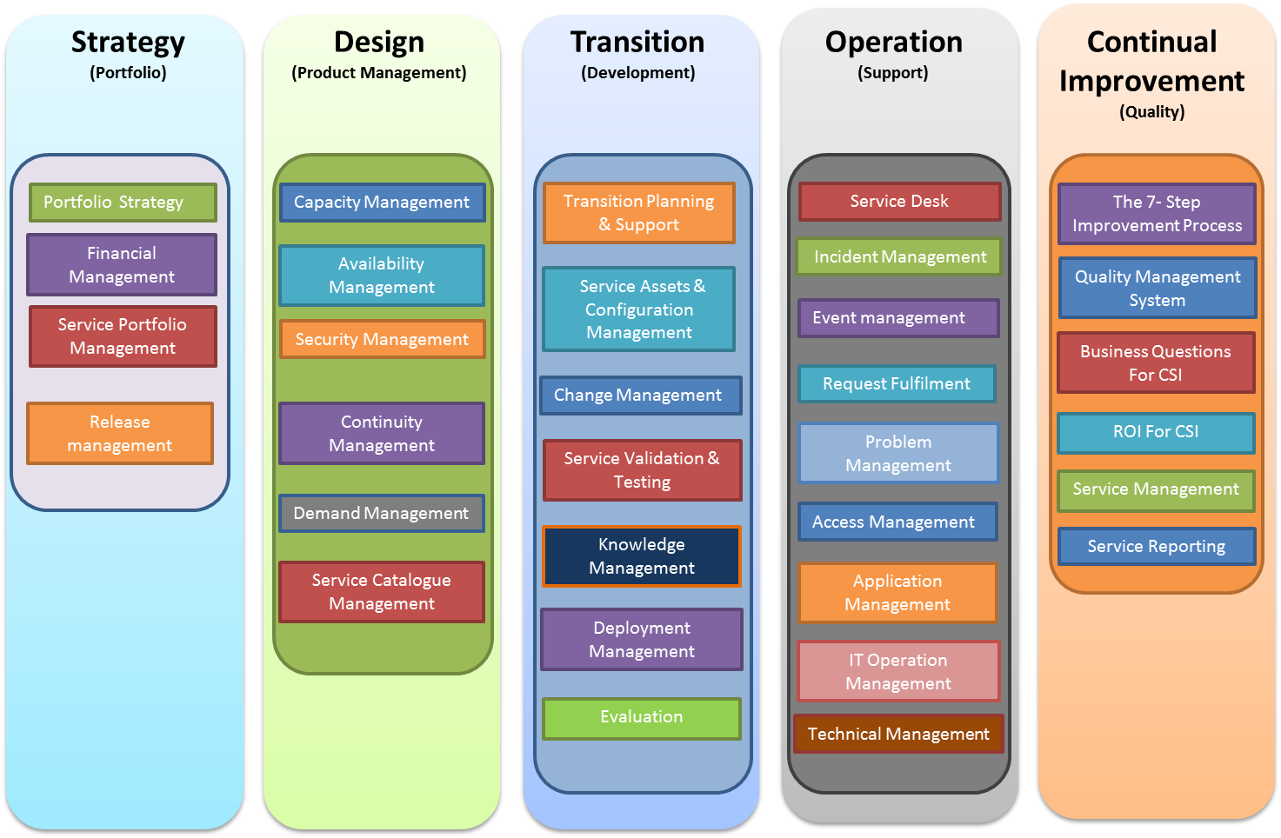
ITIL Framework
ITIL- Information Technology Infrastructure Library (‘instruction manual’ for effective IT Service)
Systematic approach to high quality IT service delivery
Documented best practice for IT Service Management
Globally accepted practise and approach as it aligns the needs of business with IT Services

Slide 8
Project Timeline
PART TIME PERIOD
SPRINT | MONTH | DURATION | DAYS | DESCRIPTION
Sprint 0 | Aug to Sep | 1.5 months | 14 | Requirements Gathering & POC (Sandbox) Product, Release Backlog Planning, Sprint Schedule
Sprint 1 | Oct to Nov | 2.0 months | 11 | Prototype Release A: Sprint 1 (POC)
FULL TIME PERIOD
SPRINT | MONTH | DURATION | DAYS | DESCRIPTION
Sprint 2 | Dec | 1.0 month | 21 | Pilot Sprint 2
Sprint 3 | Jan | 1.0 month | 21 | Pilot Release B: Sprint 3
Sprint 4 | Feb | 1.0 month | 20 | Public Go-Live V1.0 Sprint 4
Sprint 5 | Mar | 1.0 month | 23 | Public Go-Live V1.0 Release C: Sprint 5

Slide 9
Project Strategy Highlight
Project development methodology followed – AGILE software development
Requirement:
Conduct meetings before every sprint and gather requirements from product owner.
Conduct sprint retrospectives to continuously evolve and improve throughout the life of a project.
Review user’s existing system and do analysis of features that can be adopted in additional modules.
Read ITIL Document to derive requirements from specific ITIL process area.
The requirements derived from ITIL process areas are mapped with Enterprise processes in order to incorporate ITIL Practices in the enterprise.
Analysis & Design:
By Prototyping and OOAD approach.
Identified Domain objects
Conduct use case model survey
Produce high level design
Create design transition strategy
Taking feedback at the end of each sprint on the MVP produced.
Risk Management activities:
Develop a skill matrix.
Analyze skill gap.
Enroll for Enterprise JAVA elective .
Manage with one resource dropping out of project within the sprint.

Slide 10
Project Strategy Highlight
Code Development
To utilize reusable features from the existing system.
Maintain consistency with the existing system.
Produce stable, secure and speedy system.
Testing
To conduct testing at user environment at the end of each sprint.
Perform regressing testing to ensure no breakage in the existing system and
previously built modules.

Slide 11
Skill Matrix
Skill Name/ Resource Name | Rameswari | Vrinda | Vignesh | Zhao
Web Technology (html,js,css) | 3 | 3 | 4 | 4
Java Persistence API | 3 | 3 | 4 | 4
Prime Faces | 4 | 4 | 4 | 4
Database | 3 | 3 | 3 | 3
Application Server(Glass Fish) | 3 | 3 | 3 | 3
Enterprise Architect | 4 | 4 | 4 | 4
Apache Shiro Framework | 2 | 2 | 2 | 2
Enterprise Java | 4 | 4 | 5 | 5
Requirements gathering and Analysis | 5 | 4 | 3 | 3
Programming Concepts | 4 | 4 | 4 | 4
Project Management | 4 | 4 | 3 | 3
Software Testing | 3 | 5 | 3 | 5
ITIL Framework | 4 | 3 | 3 | 3
Agile Framework | 4 | 4 | 4 | 4
1- Not Aware
2- Aware
3- Hands on Experience
4- Able to handle complex problems
5- Subject Matter Expert

Slide 12
Skill Acquisition Plan
The minimum accepted value for a particular skill to work in this project is 3
Any resource below 3 in a particular skill set need to go for a skill acquisition process
The skill acquisition process includes :
Taking up basic elective in ISS matching the particular skill set.
Self-study to acquire the required skill set.
Approach ISS ITIL expert to gain domain knowledge
Study competitor product to understand the domain better

Slide 13
User Stories – CRUD Dialogs and Service Portfolio
 |  | Role | Activity | Entity
CRUD Dialog | As a | User | I should be able to Maintain,Copy,Create,Display,Edit | Configurationitem
 | As a | User | I should be able to Maintain,Copy,Create,Display,Edit | Configurationitemtype
 | As a | User | I should be able to Maintain,Copy,Create,Display,Edit | Configurationitemclass
 | As a | User | I should be able to Maintain,Copy,Create,Display,Edit | Configurationitemstatus
 | As a | User | I should be able to Maintain,Copy,Create,Display,Edit | Configurationitemrepository
 | As a | User | I should be able to Maintain,Copy,Create,Display,Edit | Configurationitemcategory
 | As a | User | I should be able to Maintain,Copy,Create,Display,Edit | Contract
 | As a | User | I should be able to Maintain,Copy,Create,Display,Edit | Contractcatalogue
 | As a | User | I should be able to Maintain,Copy,Create,Display,Edit | Contractcategory
 | As a | User | I should be able to Maintain,Copy,Create,Display,Edit | Contractclass
 | As a | User | I should be able to Maintain,Copy,Create,Display,Edit | Contractrepository
 | As a | User | I should be able to Maintain,Copy,Create,Display,Edit | Contracttype
 | As a | User | I should be able to Maintain,Copy,Create,Display,Edit | Service
 | As a | User | I should be able to Maintain,Copy,Create,Display,Edit | Servicecatalogue
 | As a | User | I should be able to Maintain,Copy,Create,Display,Edit | Servicecataloguecategory
 | As a | User | I should be able to Maintain,Copy,Create,Display,Edit | Servicecatalogueclass
 | As a | User | I should be able to Maintain,Copy,Create,Display,Edit | Servicecataloguetype
 | As a | User | I should be able to Maintain,Copy,Create,Display,Edit | Servicecategory
 | As a | User | I should be able to Maintain,Copy,Create,Display,Edit | Serviceclass
 | As a | User | I should be able to Maintain,Copy,Create,Display,Edit | Serviceportfolio
 | As a | User | I should be able to Maintain,Copy,Create,Display,Edit | Serviceportfoliocategory
 | As a | User | I should be able to Maintain,Copy,Create,Display,Edit | Serviceportfolioclass
 | As a | User | I should be able to Maintain,Copy,Create,Display,Edit | Serviceportfoliodimensions
 | As a | User | I should be able to Maintain,Copy,Create,Display,Edit | Serviceportfoliodimensionstype
 | As a | User | I should be able to Maintain,Copy,Create,Display,Edit | Serviceportfoliogroup
 | As a | User | I should be able to Maintain,Copy,Create,Display,Edit | Serviceportfoliotype
 | As a | User | I should be able to Maintain,Copy,Create,Display,Edit | Servicequality
 | As a | User | I should be able to Maintain,Copy,Create,Display,Edit | Servicequalitycategory
 | As a | User | I should be able to Maintain,Copy,Create,Display,Edit | Servicequalityclass
 | As a | User | I should be able to Maintain,Copy,Create,Display,Edit | Servicequalitytype
 | As a | User | I should be able to Maintain,Copy,Create,Display,Edit | Servicerepository
 | As a | User | I should be able to Maintain,Copy,Create,Display,Edit | Servicestatus
 | As a | User | I should be able to Maintain,Copy,Create,Display,Edit | Servicetype

Slide 14
Service Portfolio Prototype (Scope)
View Service portfolio | As a | Service Portfolio Owner | I should be able to view the manage operations tab under my work in the login landing page
 | As a | Service Portfolio Owner | I should be able to view the option of service portfolio when I click manage operations tab.
 | As a | Service Portfolio Owner | I should be able to click on service portfolio and land on the portfolio list page.
 | As a | Service Portfolio Owner | I should be able to view all my portfolio on the portfolio list page
 | As a | Service Portfolio Owner | I should be able to filter the portfolio based on portfolio type
 | As a | Service Portfolio Owner | I should be able to filter the portfolio based on portfolio dimension type
 | As a | Service Portfolio Owner | I should be able to filter the portfolio with respect to dimensions.
 | As a | Service Portfolio Owner | I should be able to filter the portfolio based on multiple portfolio type
 | As a | Service Portfolio Owner | I should be able to filter the portfolio based on multiple dimension type
 | As a | Service Portfolio Owner | I should be able to filter the portfolio based on multiple dimension
 | As a | Service Portfolio Owner | I should be able to search the portfolio by keyword or name from the search bar
 | As a | Service Portfolio Owner | I should be navigated to the dashboard page once I click on selected portfolio
 | As a | Service Portfolio Owner | I should be able to view all combinations of dimension and dimension type
 | As a | Service Portfolio Owner | I should be able to revert any selection made inside the filter and update the lists.
 | As a | Service Portfolio Owner | I should be able to sort the portfolio list by different attributes of a portfolio
View Service in a Service Portfolio | As a | Service Portfolio Owner | I should be directed to dashboard page once I select a portfolio
 | As a | Service Portfolio Owner | I should be able to get the overview of the portfolio on the dashboard
 | As a | Service Portfolio Owner | I should be able to click on Service attributes to view their details
 | As a | Service Portfolio Owner | I should be able to view the list of services in a service portfolio
 | As a | Service Portfolio Owner | I should be able to filter the services based on different service attributes
 | As a | Service Portfolio Owner | I should be able to filter the services by service type
 | As a | Service Portfolio Owner | I should be able to filter the service by service type
 | As a | Service Portfolio Owner | I should be able to search for services by search keyword
 | As a | Service Portfolio Owner | I should be able to view the updated lists after the filters are applied
 | As a | Service Portfolio Owner | I should be able to click on service to get the service overview

Slide 15
Technical Challenges
Challenges | Architectural Decisions
The entities were generated and there were some discrepancies in their relationship | The relationships will be manually changed and JPA will update the database with the new schema.
The version control system was a local repository and the systems must be connected to the local network to access the code repository. Hence, merge conflicts were high. | Segregate development work based on use cases and avoid overlapping responsibilities to avoid conflicts during commits.
The integration points were not aforementioned and hence, integration decisions were unknown during development. | Design the system in such a way that existing modules and future modules would easily be interfaced with it.
The technology being used was new and the team was not well-versed with it. | Brainstorm and take the enterprise java elective to get more training on the technology being used.

Slide 16
PROJECT RISKS
Description |  |  |  |  | Preventative Actions | Contingency Actions
Risk Item | Description of Risk | Risk Type | Risk Resolution Technique | Priority Rating
Ambiguities in Requirements | When: We work on this project for Instant Edge. Since it’s a new product and the requirements for this module depends on the success previous module. The previous module will go live with the first in october, so requirements are still ambiguous from client's side. Then: It is sometimes difficult to define and finalize project requirements as we are not sure of what to keep and what not to. | Customer Risk | Risk Localization | M | All team members to study existing software which provide similar services, and understand what the common requirements for such kind platforms are. | The team members approached ISS teachers and studied different competitor products to gain knowlwdge and take feedbacks .
Lack of technical skills in different programming languages and platforms | When: Team members have in-depth knowledge in a particular programming language but, not broad based programming experience. Then:It may takes time for the developer to research and understand the new technologies it may lead to risk of project schedule being over run, Increase cost of the project and can introduce more defects in the system due to lack of experience. | Technology Risk | Risk Localization | H | Team requires to gain knowledge by reading books or taking online training on different technologies which they are not comfortable with. Skills matrix have been designed to understand weak areas of team members so, that thay can sharpen their skills. | To seek guidance from programming language experts for technical issues faced like all the members of the team were required to take up ejava course as thier elective, and in the event of failure, in accordance with client and project co-ordinator reduce the scope of the project
Lack of domain knowledge | When: Team members have in-depth knowledge in a particular domain but, not broad based on ITIL Framework. Then:It may takes time for the team to research and understand the new framework it may lead to risk of project schedule being over run, Increase cost of the project and can introduce more defects in the system due to lack of experience. | Technology Risk | Risk Localization | H | Team requires to gain knowledge by reading books or taking online training on different technologies which they are not comfortable with. Skills matrix have been designed to understand weak areas of team members so, that thay can sharpen their skills. | To seek guidance from programming language experts for technical issues faced, and in the event of failure, in accordance with client and project co-ordinator reduce the scope of the project. Lot of book on ITIL best practises were read by the team members.
Team members unable to attend discussions and hand in deliverables on time | When: Project team members not able to attend the weekly discussions, and/or unable to hand in the tasks assigned to them on time due to what ever reasons. Then: Delay in project schedule due to fixed resources and schedule. | Management Risk | Risk Transfer | M | Make sure that each member reports to the project manager about his/her travel schedule at least for the next 3 months, so that the PM can plan early and minimize the risk. | Find a backup of the people who travel and reassign his work to someone else in the team.
Lack of Human Resources | When: At the mid of sprint 1, one of our techical lead dropped out of the project. Only 4 members remained in the team (FT4). Then: The team is short-staffed and lack of resources to work on various types of deliverablies for sprint 1 | Resources Risk (Human Resources) | Risk Insurance | H | To emphasize to the team the significance of this project and encourage people to stay. | To divide the work equally among all the remaining Team members and request for reducing the scope if possible.

Slide 17
Management Problems
The team was not on-board with the management framework of the firm. Hence, monitoring and tracking progress became a tedious task of maintaining workbooks and manual entry and calculation of efforts.
The user stories were abstract with respect to ITIL and the true scope of the project was not well-defined. Hence it was not possible to estimate the project schedule with precision.

Slide 18
Sprint Achievement Highlights
The scope of the sprint was completed without having to extend the duration of the development to next sprint.
The team was successfully able to complete all the planned tasks despite resource shortage (a team member quit the project half way through the sprint ).
The POC developed was up to the expectations of the Sponsor and even included some components new to the system(Delighters).
The team was effectively managed with daily progress reviews and was able to finish the sprint despite the resource deficiency mid-way.

Slide 19
Project Estimation
Total No of Working day in Sprint 1 = 16 Days (8Weeks)
No of Hours per day = 8 Hour
No of Resource = 5
Total No of Man Hour for sprint 1= 16*8*5 = 640
Effort per person for Sprint Planning and retrospective meeting = 1 day = 8Hour
Total effort for Sprint Planning and Retrospective = 8*5 = 40 Hour
Effort per person for Stand up meeting, Work Division and issues resolution = 1 hour/day
Effort per Person for the sprint = 16 hour
Effort for the team = 16*5 = 80 hour
Effective Working hour = 640 - (80+40) = 520
Total Story points allocated in sprint 1 = 197
So hours per point = 520/197 = 2.38 hour
As per Instant Edge standards 1 Story point = 2 hour
As we are doing the sprint for the first time hours allocated = 3hrs /point

Slide 20
Project Progress Tracker
Days | Planned Hours Burndown | Actual Hours burndown
0 | 582 | 582
1 | 542 | 550
2 | 502 | 518
3 | 462 | 482
4 | 422 | 444
5 | 382 | 404
6 | 342 | 364
7 | 302 | 344
8 | 262 | 368
9 | 220 | 324
10 | 180 | 280
11 | 140 | 236
12 | 100 | 192
13 | 60 | 148
14 | 20 | 100
15 | 0 | 56
16 | 0 | 12

Slide 21
Project Estimation Sample
Story Point | Task | No of Hours | Planned start Date | Planned End date | Actual start Date | Actual End date | Resource
5 | Create page for "Create Configurationitem" | 0.5 | 20/09/2016 | 20/09/2016 | 20/09/2016 | 20/09/2016 | Rameswari
 | Create page for "Edit Configurationitem" | 0.5 | 20/09/2016 | 20/09/2016 | 20/09/2016 | 20/09/2016 | Rameswari
 | Create page for "Display Configurationitem" | 0.5 | 20/09/2016 | 20/09/2016 | 20/09/2016 | 20/09/2016 | Rameswari
 | Create page for "Copy Configurationitem" | 0.5 | 20/09/2016 | 20/09/2016 | 20/09/2016 | 20/09/2016 | Rameswari
 | Create page for "Maintain Configurationitem" | 0.5 | 20/09/2016 | 20/09/2016 | 20/09/2016 | 20/09/2016 | Rameswari
 | Create page for "List Configurationitem" | 0.5 | 20/09/2016 | 20/09/2016 | 20/09/2016 | 20/09/2016 | Rameswari
 | Create controller "ConfigurationitemManagedBean" | 2 | 20/09/2016 | 20/09/2016 | 20/09/2016 | 20/09/2016 | Rameswari
 | Create exceptions for "Configurationitem" | 0.5 | 20/09/2016 | 20/09/2016 | 20/09/2016 | 20/09/2016 | Rameswari
 | Create service interface "ConfigurationitemService" | 2 | 20/09/2016 | 20/09/2016 | 20/09/2016 | 20/09/2016 | Rameswari
 | Create service "DefaultConfigurationitemService" | 1 | 20/09/2016 | 23/09/2016 | 20/09/2016 | 23/09/2016 | Rameswari
 | Create domain entity "Configurationitem" | 0.5 | 23/09/2016 | 23/09/2016 | 23/09/2016 | 23/09/2016 | Rameswari
 | Test Configurationitem | 6 | 11/10/2016 | 11/10/2016 | 11/10/2016 | 11/10/2016 | Rameswari
5 | Create page for "Create contract" | 0.5 | 20/09/2016 | 20/09/2016 | 20/09/2016 | 20/09/2016 | Vignesh
 | Create page for "Edit contract" | 0.5 | 20/09/2016 | 20/09/2016 | 20/09/2016 | 20/09/2016 | Vignesh
 | Create page for "Display contract" | 0.5 | 20/09/2016 | 20/09/2016 | 20/09/2016 | 20/09/2016 | Vignesh
 | Create page for "Copy contract" | 0.5 | 20/09/2016 | 20/09/2016 | 20/09/2016 | 20/09/2016 | Vignesh
 | Create page for "Maintain contract" | 0.5 | 20/09/2016 | 20/09/2016 | 20/09/2016 | 20/09/2016 | Vignesh
 | Create page for "List contract" | 0.5 | 20/09/2016 | 20/09/2016 | 20/09/2016 | 20/09/2016 | Vignesh
 | Create controller "contractManagedBean" | 2 | 20/09/2016 | 20/09/2016 | 20/09/2016 | 20/09/2016 | Vignesh
 | Create exceptions for "contract" | 0.5 | 20/09/2016 | 20/09/2016 | 20/09/2016 | 20/09/2016 | Vignesh
 | Create service interface "contractService" | 2 | 20/09/2016 | 20/09/2016 | 20/09/2016 | 20/09/2016 | Vignesh
 | Create service "DefaultcontractService" | 1 | 20/09/2016 | 23/09/2016 | 20/09/2016 | 23/09/2016 | Vignesh
 | Create domain entity "contract" | 0.5 | 23/09/2016 | 23/09/2016 | 23/09/2016 | 23/09/2016 | Vignesh
 | Test contract | 6 | 11/10/2016 | 11/10/2016 | 11/10/2016 | 11/10/2016 | Vignesh

Slide 22
Service Portfolio Management
Service Portfolio management is a complete set of services that are managed by a service provider. It is basically used to manage entire lifecycle of all services.
Service Portfolio is a collection of service catalog that includes all relevant details about each service :
Associated Service level agreements (SLAs)
Who is able to request it
How much it costs
How to fulfill it.
Through the service portfolio, both you and your users can gain greater visibility of services. Users will be able to quickly find and acquire the services they need, and Service provider will be able to make better-informed, business-based decisions regarding services.

Slide 23
Service Portfolio Management
Service Portfolio Management is a dynamic and ongoing process that covers the following stages in work practices:
Define - list services, confirm business cases and verify portfolio data
Service Pipeline ( Proposed or in development)
Service Catalogue( Live or Available services)
Retired Services( Live but are not available for further development)
Analyze - maximize portfolio value, set priorities
Define long term goal of the service organization
Services required to meet the goal
Capability and resources required to achieve those services
Approve - finalize portfolio proposal, authorize services and resources
Retain- well defined asset , services are aligned with organization strategy
Replace- unclear and overlapping functionality
Rationalize-Services comprising of multiple version or release.
Refactor-Refactor the service to include only core functionality
Renew- Meet functional fitness but fail technical fitness.
Retired- Services that do not meet minimum level of technical or functional fitness
Charter - Communicate decision and allocate resources.

Slide 24

Portfolio1 Service Portfolio Dashboard
Services
100
Incidents
Performance
70%
Incident
120
Customer
70%
Active
70
Critical 40
Acknowledged 60
Incidents
20%
In Active
20
Pending 20
Resolved 40
Profit
10%
Retired
10
Penalties
$
10%
Supplier
Service Catalogue
Info
Portfolio Owner
Finance
$50000
Investment
$
70%
60
150
Revenue
$
20%
Profit
$
10%
Plan Manager
Build Manager
Run Manager
Notes:
User:
On clicking a service portfolio from the list, the user arrives at the Service Portfolio Dashboard.
Can view all the related attributes of the selected Service Portfolio like Performance, Services, Service Catalogues, Financial information, etc.
At the end of the dashboard, the user can view thee graphs showing the performance, financials and incidents over a period of time.

Slide 25
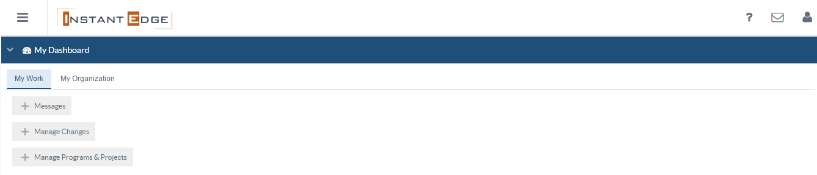
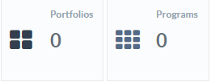
Manage Operations
Service portfolio
Service catalogue
20
50
Notes:
User:
Clicks on the Service portfolio tile to view the list of service portfolio

Slide 26


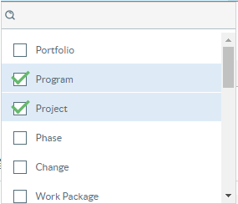

Service Portfolio List
Program
Project
Portfolio Type
1 | Portfolio-1 | xyz | 2
2 | Portfolio-2 | xyz | 2
3 | Portfolio-3 | xyz | 3
4 | Portfolio-4 | xyz | 1
Notes:
Once multiple selection is done the list is reduced to the smallest matching subset.

Slide 27
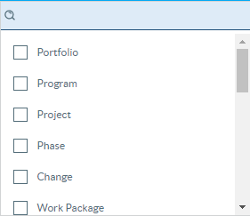

Service Portfolio List
Program
Program
India
Portfolio Type
1 | Portfolio-1 | xyz | 2
2 | Portfolio-2 | xyz | 2
3 | Portfolio-3 | xyz | 3
Portfolio Dimension
Location
India
India
Singapore
China
HR
Japan
Malaysia
Germany

Slide 28
Service Portfolio List
Program
Program
India
IT
Portfolio Type
1 | Portfolio-1 | xyz | 2
2 | Portfolio-2 | xyz | 2
Portfolio Dimension
Location
Advisory
Tax
IT
IT
Audit
xyz
abc
pqr

Slide 29
Portfolio1 Service Portfolio Dashboard
Services
100
Incidents
Performance
Incident
Active
70
In Active
20
Retired
10
Supplier
Service Catalogue
Info
60
150
Notes:
User:
On clicking a service portfolio from the list, the user arrives at the Service Portfolio Dashboard.
Can view all the related attributes of the selected Service Portfolio like Performance, Services, Service Catalogues, Financial information, etc.
At the end of the dashboard, the user can view thee graphs showing the performance, financials and incidents over a period of time.

Slide 30

Portfolio1 Service Portfolio - Services
Service name | Service Owner | Status | Performance
xyx | cxbcxczbcxz | Active | 60%
cxvcx | xbcxbx | Active | 70%
xzvxv | cxvcxb | Inactive | 20%
xvxv | cvcxb | Inactive | 30%
xzvxv | xcbcx | Inactive | 40%
zxvxv | cbcxb | Active | 20%
xvcxbv | xcbcxbcxbn | Retired | 40%
Status
Active
Inactive
Retired

Slide 31
Portfolio1 Service Portfolio - Services
Service name | Manager | Status | Performance
xyx | cxbcxczbcxz | Active | 60%
cxvcx | xbcxbx | Active | 70%
zxvxv | cbcxb | Active | 20%
Status
Active
Inactive
Retired

Slide 32
XYX- Services
Service Name: XYX
Service owner: Mr. Jack Kun Lee
Service Status : Active
Service Type : IT
Service Category : IT
Service Description : Be careful not to write a book that describes the service, refrain from technical wording and keep acronyms to a minimum. The goal is to write a clear, concise and quotable description that everyone can understand, support and recite.
Notes:
ON clicking any of the frames or panels, a new panel opens at the bottom show the details of the selected item.
For example, on clicking Services, a panel containing the list of all services opens at the bottom with a filter panel on the left that allows the user to sort, filter the list.
Current lifecycle status of the service
"Proposed", "Defined", "Chartered", "Designed", "Built", "Tested", "Released", "Operational", "Retired"
Service Type
External Customer-facing : The external customer facing service is delivered to another company. Its efficiency could be easily measured through the revenue it will generate
Internal Customer-facing : The internal customer facing services will be provided inside a company or organization from one service or department to another.
Supporting service : A supporting service is not directly used by the business, but is required by the IT service provider to deliver customer-facing services.
Service Owner
responsibility for service provisioning
Customers
customers currently using this service
Contacts and procedures for signing up to the service
e.g. contact details of the responsible Service Level Manager
Procedure for signing up
Description/ desired customer outcome
Desired outcome in terms of utility (example: "Field staff can access enterprise applications xxx and yyy without being constrained by location or time")
Desired outcome in terms of warranty (example: "Access is facilitated worldwide in a secure and reliable manner")

Slide 33
Service Portfolio Management Example
Portfolio – Graduate Programs
Portfolio Type - Courses
Dimension Type –
Customer Segment
Dimensions
Graduate
Professional
2. Course Type
Dimensions
Technical
Management
Analytical
Services
SE- Active
KE- Active
EBAC- Active
IT Leadership-Active
Portfolio – Executive Education
Portfolio Type - Courses
Dimension Type –
Customer Segment
Dimensions
Professional
General Public
2. Course Type
Dimensions
Technical
Management
Analytical
Services
Analytics –Active
Agile- Active
Cyber security- Active
Portfolio–E-Government Leadership
Portfolio Type - Courses
Dimension Type –
Customer Segment
Dimensions
Government
2. Course Type
Dimensions
Technical
Management
Analytical
Services
Smart Nation-Active
Service Innovation- Active
Digital Government
Transformation- Active

Slide 34
Service Portfolio Management Implementation

Slide 35
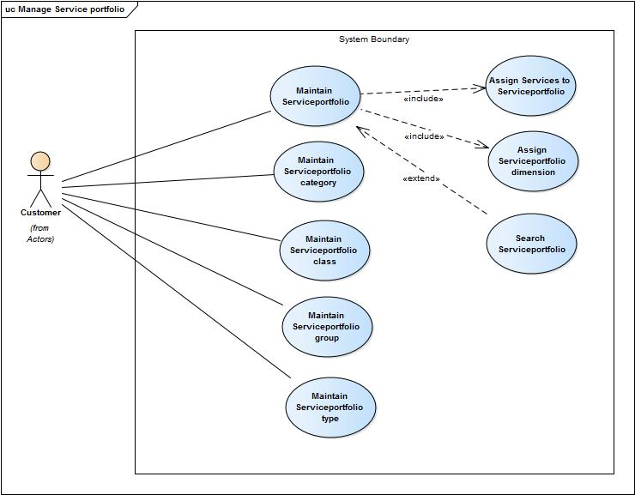
Use Case Diagrams
Manage Service portfolio

Slide 36
Software Architecture

Slide 37

DEMO

